Slide 1
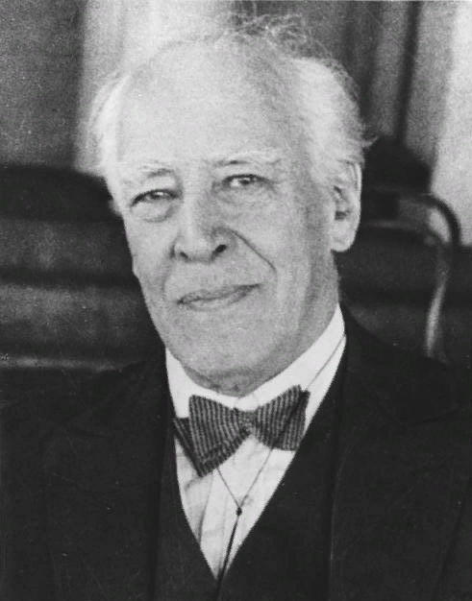
Stanislavksi’s system (contains topic «Mysteries of human mind»)
DREC MIPT, 3 year
EGOR BATARIN
https://upload.wikimedia.org/wikipedia/commons/6/66/Bundesarchiv_Bild_183-18073-0003%2C_Konstantin_Sergejewitsch_Stanislawski.jpg

Slide 2
Header
1. Why Stanislavski?
2. Principles of the system.
3. Techniques of stage creativity.
4. Life example - meeting of two mathematicians at a conference.

Slide 3
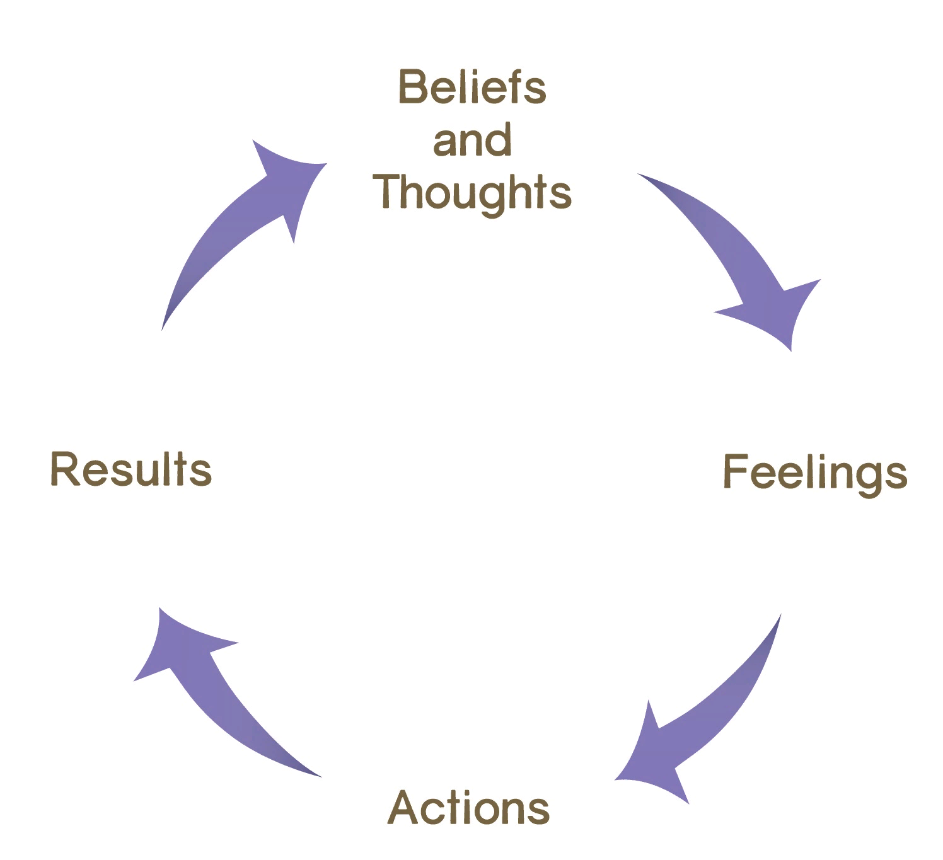
Why Stanislavski?
https://images.huffingtonpost.com/2014-06-20-AmIHungryTFAR.jpg

Slide 4
Principles of the system.
1) The principle of vital truth
2) The principle of the super task
3) The principle of activity of action
4) The principle of organicity
5) The principle of reincarnation

Slide 5
Techniques of stage creativity.
Proposed circumstances
Action
Emotional memory
Feeling 1
Sadness
Feeling 2
Anger
Feeling 3
Happiness

Slide 6
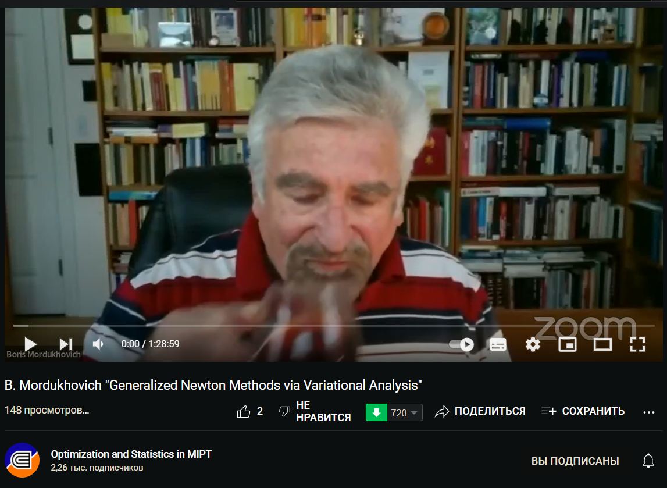
A life example

Slide 7
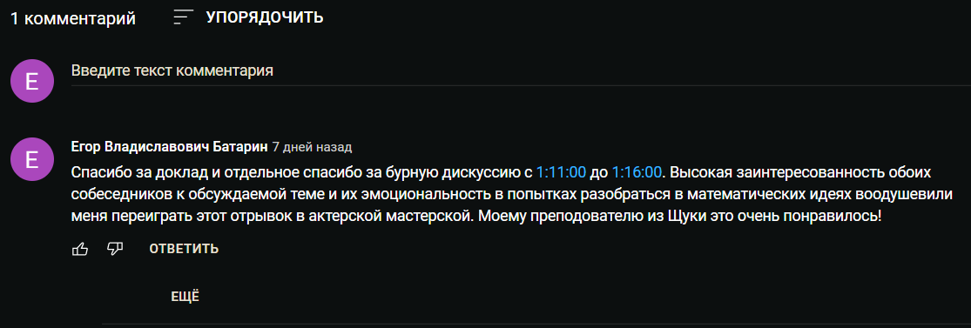
Thank you for your attention!

